Slide 1
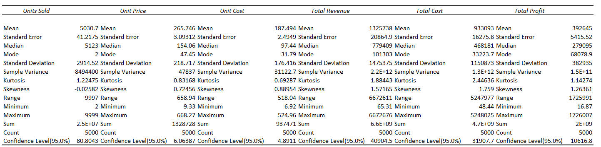
5000 sales record.csv descriptive analysis of profit variables

Slide 2
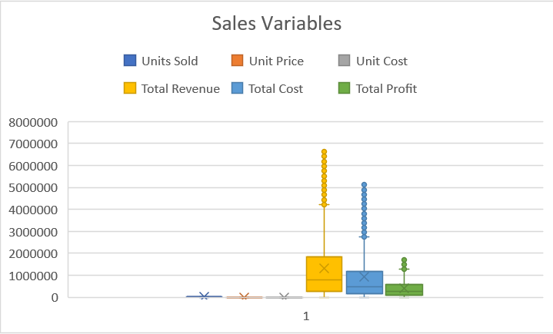
Range
Variables

Slide 3
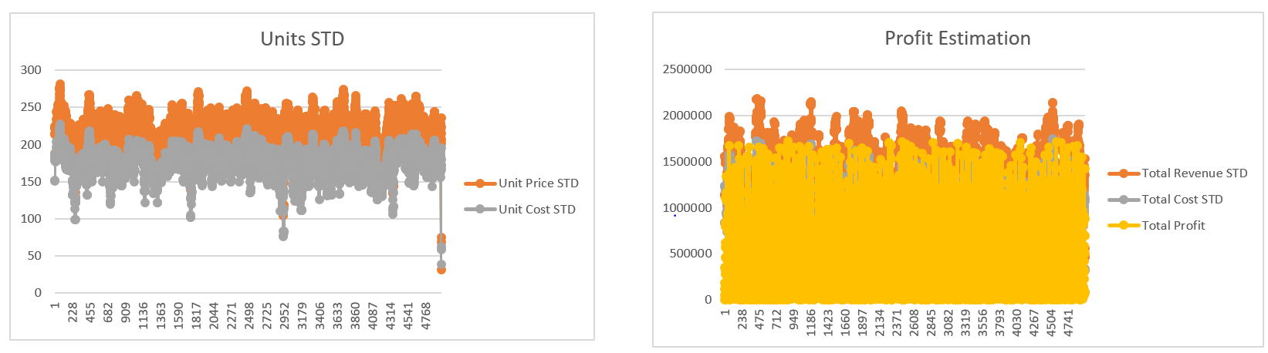
Range
No.of.Units
Unit prices are 33% higher than Unit costs
Total Cost STD almost similar to Total profits

Slide 4
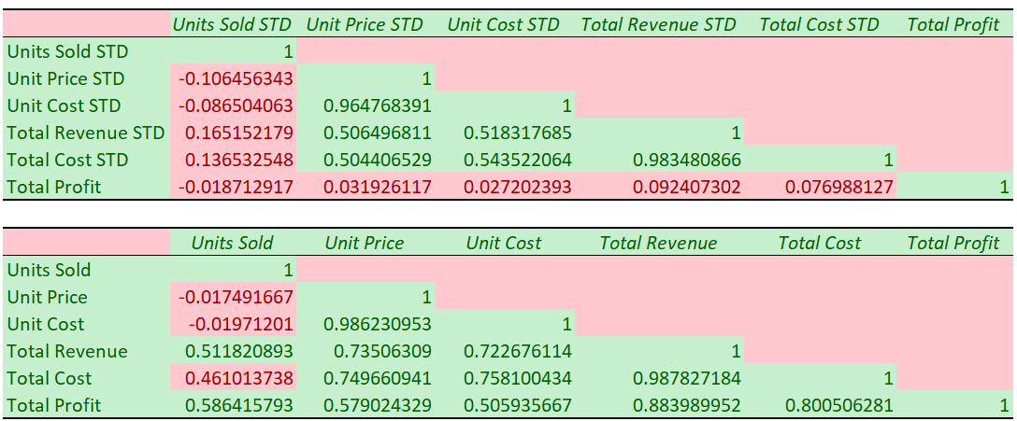
Correlation Matrix with 30points rolling STD data and actual data of profit variables
30 points rolling STD supports seasoned sales to be concentrated for profits.

Slide 5
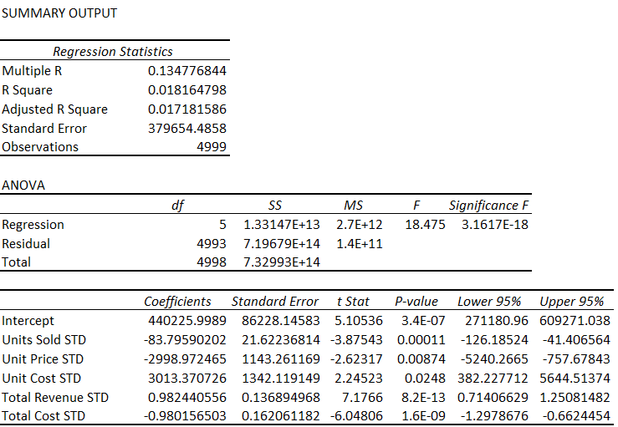

Slide 6
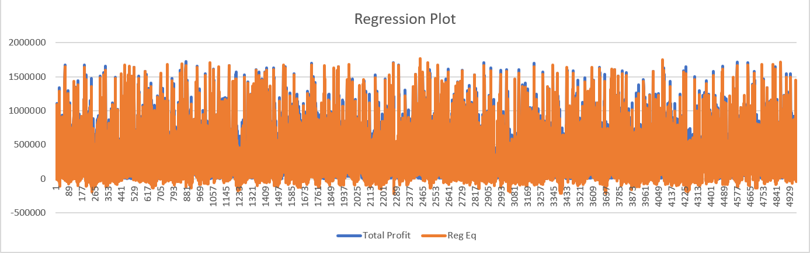
Range
No.of.Units

